Slide 1
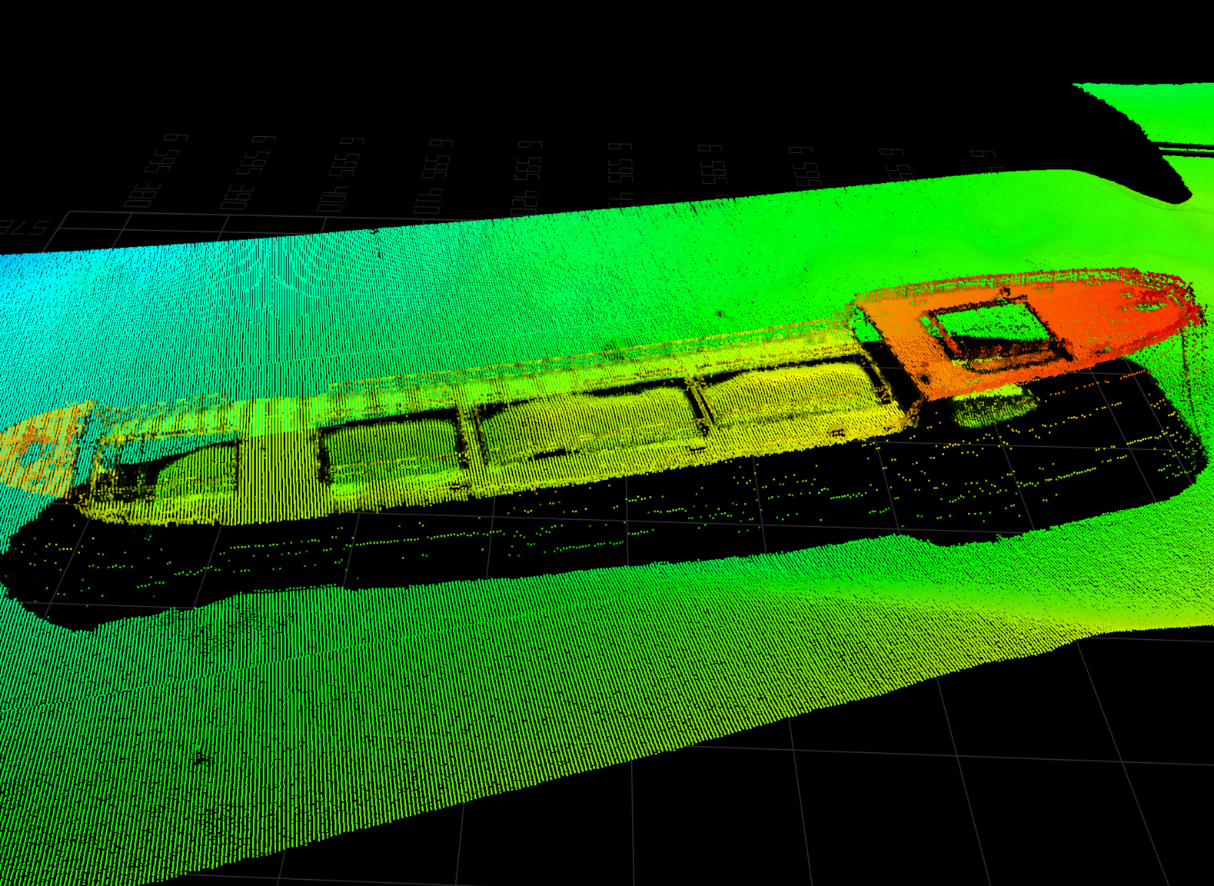
EM®2042
Multibeam echo sounder for shallow waters
FEATURING
Next generation of multi-transmitter MBES
Full 4D motion compensation
High resolution multi-frequency bathymetry and seabed backscatter
Engineered to surpass IHO Exclusive Order / LINZ Special Standard
Seamless integration with SIS- and 3rd party software
EM®2042
Introducing the EM2042, the next generation of EM multibeam echo sounder that takes seabed mapping to new depths, by delivering unparalleled accuracy and resolution to your surveys. In the field of hydrography, offshore industry, dredging and marine science, the EM2042 is the perfect tool for your underwater mapping needs. The ease of use and advanced features make it a must-have for professionals who demand the best data quality, reliability, and flexibility.
Components
The EM2042 can be delivered with a 0.4 or 0.7 beam width (@400kHz) transmitter, with a single or dual 0.7 receiver optionally embedding a KONGSBERG miniMRU, and an AML sound velocity sensor. The transmitter and receiver are connected to the topside processing unit through a single subsea cable, making it easy to set up and operate. Only EM® has the unrivaled dual RX variation, requiring only one TX array, generating up to 4096 soundings. The unique EM 2042 transmitter combines three transmit sectors to enable dynamic focusing on both transmission and reception, as well as roll, pitch and real 3-sector yaw stabilization. The EM 2042 transducers are 60% lighter than the previous generation and have reduced the total power consumption. A custom-made portable bracket for over-the-board installations can accommodate integration, in a fixed location with known offsets, for the most used INS sensors in hydrography, allowing a quick and easy setup.
OPTIONS
Water column data logging
Embedded miniMRU in the receiver
Embedded SV sensor in the receiver
EM® HighFrequency mode
Enhanced EM® MultiFrequency Backscatter mode
Extra detections
QuadSwathTM
PredictivePitchTM
Portable mount for over the board installations
Easy upgrade for EM2040 users
496233/B

Slide 2
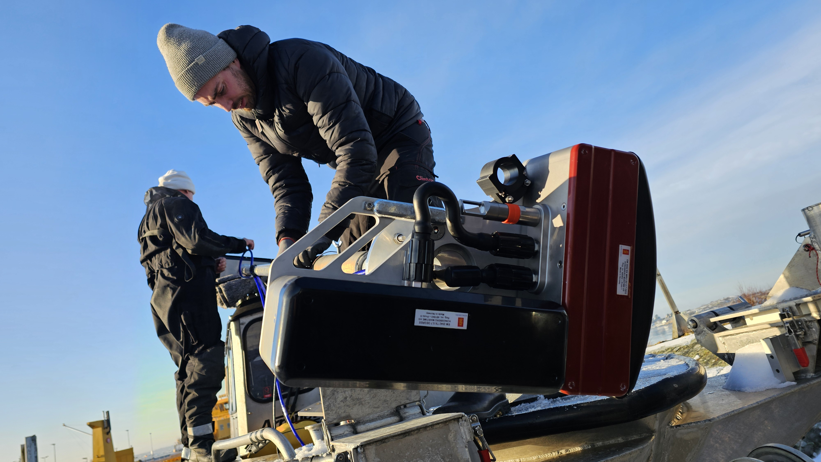
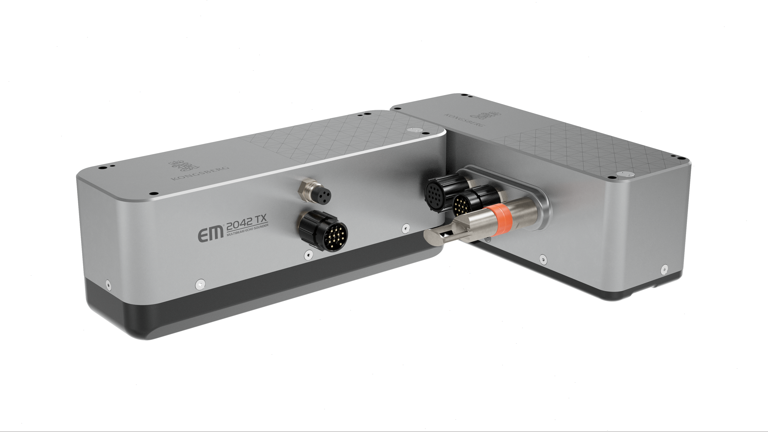
Improved frequency range
EM2042 features a wideband frequency range from 150 kHz to 700 kHz, offering different modes for various applications:
300 kHz: Ideal for most mapping tasks, balancing range and resolution
400 kHz: Optimized for inspection work
600 kHz and 700 kHz: Enhance small object detection and 3D mapping
200 kHz: Extends the range down to 600 meters
A new 150 kHz band complements EM® MultiFrequency mode, improving seabed classification in a single pass
New feature – Ready for PredictivePitchTM
This new and cutting-edge feature uses KONGSBERG Seapath algorithm to accurately steer the beams along track to their future pitch angle. This provides more accurate and reliable detections even on fast-moving platforms like small USVs exposed to challenging sea conditions.
New Feature – Ready for QuadSwathTM
The EM 2042 is ready to deliver up to 4 swaths per ping cycle, ensuring the most demanding sounding density requirements, and improving the definition of seafloor features in high-speed surveys.
Technical specifications
EM2042
Frequency range | 150 – 700 kHz
Ping rate | Up to 5 Hz
Number of soundings | Single RX: Up to 2048
 | Dual RX: Up to 4096
Swath coverage | Up to 170° (single RX) / 220° (dual RX)
Depth range | 0.5 m to max 600 m
Depth rating | 50 m
Beam stabilisation | Roll (± 15°), pitch (± 10°), yaw (± 10°)
Pulse form | CW / FM (CHIRP modulation)
Bandwidth | >120 kHz
Shortest pulse length | 14 µs
Depth accuracy | Up to 5.5 mm
Embedded Kongsberg MRU angular accuracy (RMS) | Up to 0.01º Roll and Pitch. 0.04º Heading (Seapath 2.5m baseline)
Embedded SV | AML X2changeTM SVT sensor
Power requirements | 93 W
Software compatibility | Kongsberg SIS, QPS, CARIS, EIVA, Beamworx, PDS, SonarWiz
Hydrographic Workstation (HWS) and monitor can be delivered on request. Specifications subject to change without any further notice.
EM® is a registered trademark of Kongsberg Discovery AS in Norway and other countries.
496233/B

Slide 3
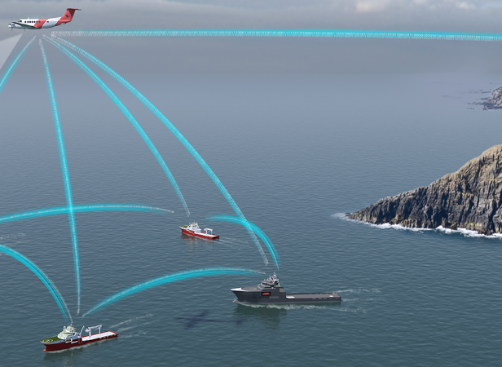
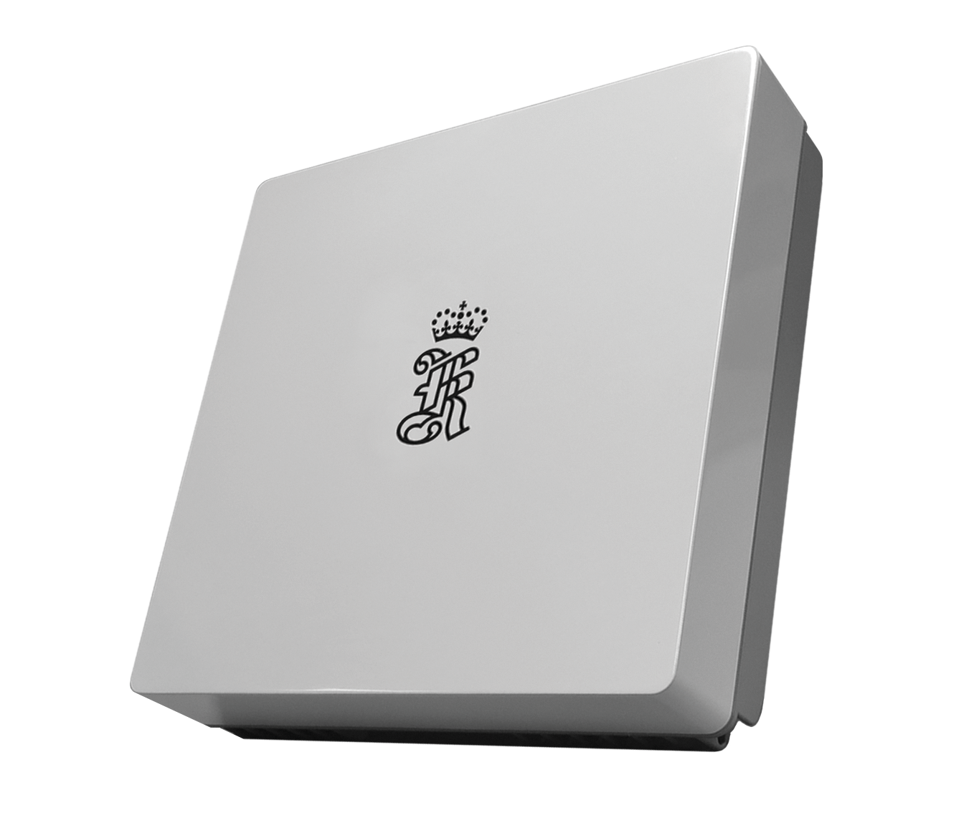
MBR 179 MKII
Maritime Broadband Radio
The Maritime Broadband Radio is a smart antenna designed for use in any application where resilient high-speed communication and high-capacity data transfer are crucial for efficient and safe operation. With beamforming the MBR 179 provides steerable high-gain antenna direction in an omnidirectional sector, ideal for vessels and moving assets. With narrow fan shaped antenna diagram, a strong link margin is maintained and continuously updated as the unit is unaffected of vessel movements.
Technical specifications
PERFORMANCE
Range
Operational range | 45 km
User data | 0.7 to 16.5 Mbps
Antenna coverage
Omni-directional | 360 degrees azimuth
RF Specifications
Frequency band | 4900 MHz to 5900 MHz
Channel bandwidth | 20 MHz
Tx power | Up to 4 W
Antenna gain | 21 dBi
EIRP | Max 57 dBm
Modulation | GMSK
Internal antenna elements | 60
INTERFACES
Ethernet/LAN | 1x RJ-45
WEIGHTS AND DIMENSIONS
MBR Unit | 8.8 kg, 323 x 323 x 111 mm
POWER
Supply voltage | 24 – 48 V DC
Max. Power consumption, full TX | 210 W
ENVIRONMENTAL SPECIFICATIONS
Operational temp. range
MBR Unit | -40°C - +55°C
Humidity (operating/storage)
MBR Unit (recommended) | 20 to 100 % RH / 20 to 70 % RH
Ingress protection
MBR Unit | IP66
STANDARDS AND REGULATIONS
MBR is in conformity with RED directive 2014/53/EU
EMC | ETSI EN 301 843-1 ETSI EN 301 843-7 IEC 60945/EN 60945
Radio | ETSI EN 303 276
Product safety | IEC 61010-1/EN 61010-1
Environmental | IEC 60945/EN 60945 DNVGL-CG-0339 (48 V DC) IACS E10 (48 V DC)
XXX-XXXXXX/A

Slide 4


Simrad EQ50
Single-beam multi-ferquency fish-finding echo sounder
KEY SPECIFICATIONS
Frequencies:
38 kHz
70 kHz
120 kHz
200 kHz
Number of beams: 1 for each operating frequency
Pulse types: CW or FM
Range: 1000m (depending on chosen operating frequency and the acoustic conditions)
Interfaces: Position, attitude and heading
Internal sensor: Temperature
Cable length: 20 metres
The specifications are those valid for the EQ50 with the Simrad C-All transducer
The Simrad EQ50 echo sounder is the perfect tool for any angler, boater or marine enthusiast! If you want to improve your fishing efficiency and do not need the features offered by a split-beam echo sounder, the Simrad EQ50 is the perfect choice. Four different operating frequencies are available with a single transceiver unit.
The Simrad EQ50 uses the same physical units as the well-known Simrad ES80 echo sounder but with single-beam transducers. The Simrad C-All multi-frequency transducer is the best match for the EQ50.
Visit www.kongsberg.com/eq50 for more information, the latest software version, and the end-user documentation.
110-0045795 Rev. A

